Slide 1
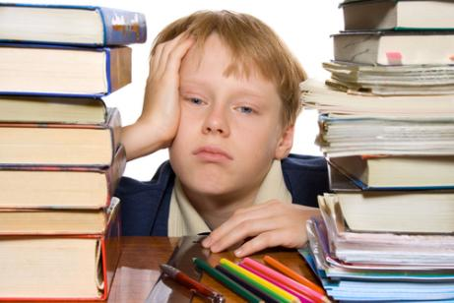

Slide 2
CHAPTER 3: PREVIEW
FUTURE TIME
When … he … study?
When is he going to study?

Slide 3
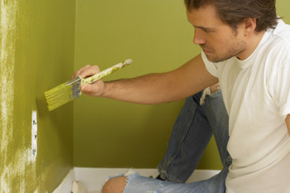
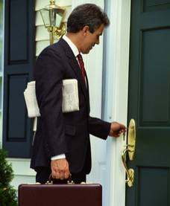
11-6 USING WHAT + A FORM OF DO
FUTURE
What are you going to do next week?
I’m going to paint my bedroom.

Slide 4
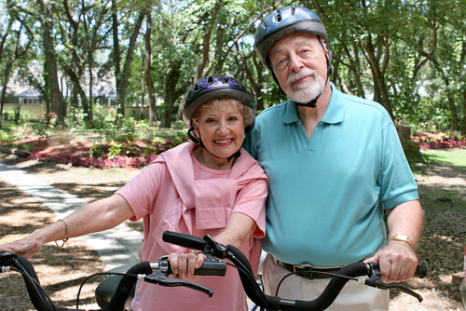
3-1 EXPRESSING FUTURE TIME: BE GOING TO
AND WILL
They are going to have a picnic
in the park this afternoon.

Slide 5

3-1 EXPRESSING FUTURE TIME: BE GOING TO
AND WILL
(a) I am going to get married in one hour.

Slide 6

3-1 EXPRESSING FUTURE TIME: BE GOING TO
AND WILL
(c) Mayur is going to get married in one hour.

Slide 7
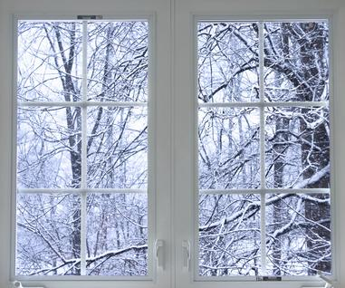
3-2 FORMS WITH BE GOING TO
It is going to snow again tomorrow.

Slide 8
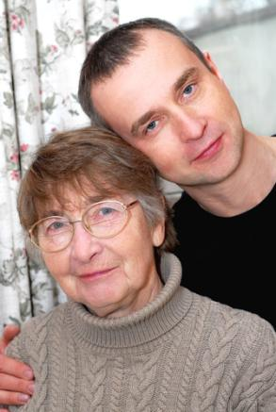
3-2 FORMS WITH BE GOING TO
(a) His mother is going to be 65 years old tomorrow.

Slide 9

3-2 FORMS WITH BE GOING TO
(a) His mother is going to be 65 years old tomorrow.
(b) Her family’s going to have a party.
INCORRECT: Her family’s going to haves a party.

Slide 10
3-2 FORMS WITH BE GOING TO
(c)
Am I going to go to the party?
Is he, she, it going to go to the party?
Are they, we, you going to go to the party?
QUESTION: be + subject + going to

Slide 11
3-2 FORMS WITH BE GOING TO
(d)
I am not
He, she, it is not
They, we, you are not
going to go
to the party.
NEGATIVE: be + not + going to

Slide 12

3-2 FORMS WITH BE GOING TO
(e) “Come on, we’re going to go to the party!”
informal
not
written
Be
gonna
going
to

Slide 13
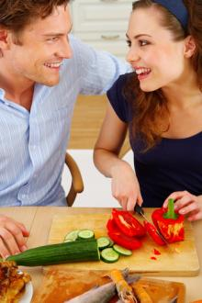
3-1, 3-2 LET'S PRACTICE
be going to
we, eat
are we going to eat
What ________________ for dinner?

Slide 14
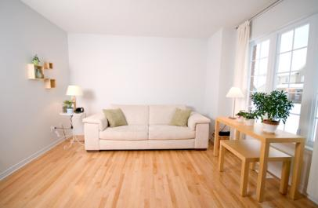
3-1, 3-2 LET'S PRACTICE
be going to
you, paint
are you going to paint
What color __________________
your living room?

Slide 15
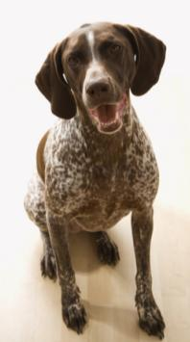
3-1, 3-2 LET'S PRACTICE
be going to
bark
going to bark
___ that dog ___________ all day?
Is

Slide 16
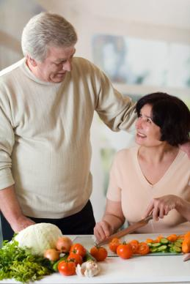
3-3 FORMS WITH WILL
Dinner will be ready in one hour.

Slide 17
3-3 FORMS WITH WILL
STATEMENT
I-You-She-He-It-We-They
will be home next week.
NEGATIVE
I-You-She-He-It-We-They
will not (won’t) be home next week.

Slide 18
3-3 FORMS WITH WILL
QUESTION
Will
I-you-she-he-it-we-they
be home next week?
SHORT
ANSWER
Yes,
I-you-she-he-it-we-they will.
No,
I-you-she-he-it-we-they won’t.

Slide 19
10-7 ASKING QUESTIONS WITH WILL
Will Tom come home tomorrow?

Slide 20
10-7 ASKING QUESTIONS WITH WILL
QUESTION
MAIN
WILL + SUBJECT + VERB
(a) Will Rita go tomorrow?
ANSWER
Yes, she will.
No, she won’t.

Slide 21
10-7 ASKING QUESTIONS WITH WILL
QUESTION
MAIN
WILL + SUBJECT + VERB
(b) Will they go home later ?
ANSWER
Yes, they will.
No, they won’t.

Slide 22
10-7 ASKING QUESTIONS WITH WILL
QUESTION
(QUESTION MAIN
WORD) + WILL + SUBJECT + VERB
(c) When will they be in London?
ANSWER
Next weekend.

Slide 23
10-7 ASKING QUESTIONS WITH WILL
QUESTION
(QUESTION MAIN
WORD) + WILL + SUBJECT + VERB
(d) What time will we go out ?
ANSWER
7:30 P.M.

Slide 24
10-7 ASKING QUESTIONS WITH WILL
QUESTION
(QUESTION MAIN
WORD) + WILL + SUBJECT + VERB
(e) Where will she study English?
ANSWER
At college.

Slide 25
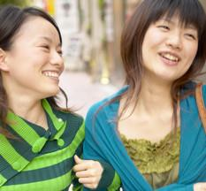
10-7 Let’s Practice
Where will you live after college
_____________________________?
Hmmm, I will live in Buenos Aires
after college.

Slide 26

10-7 Let’s Practice
Will we go out for lunch
_____________________?
Yes, we will go
out for lunch.

Slide 27
3-3 FORMS WITH WILL
CONTRACTIONS
‘
‘
‘
I
+
wi
ll
she
+
wi
ll
he
+
wi
ll
we + will
you’ll
they’ll
we’ll
you + will
they + will
pronouns + will
in speech & formal writing

Slide 28
3-5 BE GOING TO vs. WILL
(c) I made this food because we are
going to have a party.
be going to
will
prior plan

Slide 29
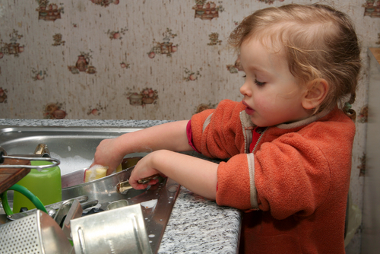
3-5 BE GOING TO vs. WILL
(d) I will help you wash the dishes.
will
be going to
present moment decision

Slide 30
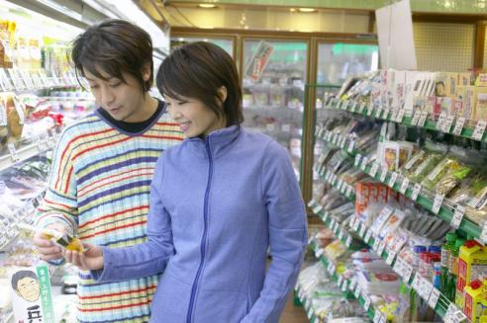
3-5 LET’S PRACTICE
be going to
will
If you need this
I _________ buy it
for you.
will

Slide 31
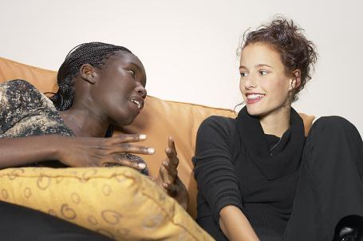
3-5 LET’S PRACTICE
be going to
will
am going to
I __________
go to college in
England.

Slide 32
3-10 LET’S PRACTICE
go
work
am going to go
I ____________ to Oxford and ______ to help pay tuition.
work

